Slide 1
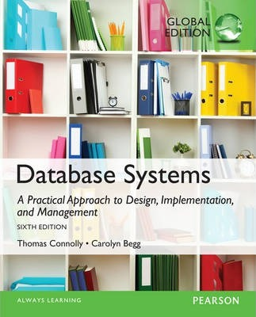
End-semester Review Part 2
Ali Chelli
Course: Database 2 (DAT2000R)

Slide 2
Stored Procedures

Slide 3
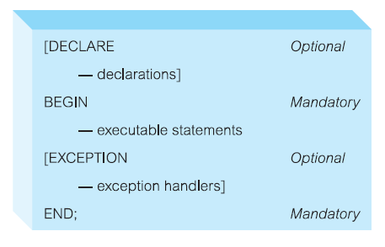
What is PL/SQL?
PL/SQL stands for Procedural Language extension of SQL.
PL/SQL is a combination of SQL along with the procedural features of programming languages.
It was developed by Oracle Corporation in the early 90’s to enhance the capabilities of SQL.
PL/SQL is a block-structured language, blocks can be entirely separate or nested within one another.

Slide 4
Stored Procedures
Program executed through a single SQL statement
Executed in the process space of the server
CREATE PROCEDURE spGetEmployees
AS
BEGIN
SELECT Name, Gender FROM Employee
END

Slide 5
Advantages of Stored Procedures
Overhead
Stored procedure statements are stored directly in the database, they may reduce the compiling overhead that is typically needed when software applications send inline SQL queries to a database.
Stored procedures are compiled only once during its creation, and it is cached in the server.
Therefore, repeated compilation is not required during execution of the procedure, thereby increasing the speed of execution.
However, if any updates are made in the procedure, then it will be re-compiled.

Slide 6
Advantages of Stored Procedures
Avoiding network traffic
Stored procedures can run directly within the database engine, this means that the procedures run entirely on a specialized database server, which has direct access to the data being accessed.
The benefit here is that network communication costs can be avoided completely.
This becomes more important for complex series of SQL statements.

Slide 7
Advantages of Stored Procedures
Encapsulating business logic
Stored procedures allow programmers to embed business logic as an API in the database
This simplify data management,
Reduce the need to encode the logic elsewhere in client programs,
Reduce data corruption by faulty client programs.
The database system can ensure data integrity and consistency with the help of stored procedures.

Slide 8
Advantages of Stored Procedures
Security
Stored procedures can be locked to only users who have the permission to execute them, which allows for more security control.
Even if an account becomes compromised the attacker still cannot execute arbitrary commands against the data and can still only access a limited subset of data.
Notes:
Stored procedures are saved on the server as an object that means they can have security permissions assigned and revoked.
This works just like any table or view object.
Users can be granted access to a stored procedure but denied access to the underlying tables that they reference as an added level of security.

Slide 9
Stored Procedures and Functions
The basic units that constitute a PL/SQL program are stored procedures and functions.
Similarities
Both take a set of parameters from the calling program and perform a set of actions
Both can modify and return data passed to them as a parameter
Differences
A function will always return a single value to the caller
A stored procedure does not necessarily return any value

Slide 10
Triggers

Slide 11
Introduction
Stored procedures:
Procedural codes to encapsulate task or calculations and execute business logic
They are safely stored on the database server
They are executed explicitly by users of the system

Slide 12
Triggers
Triggers are:
procedural codes to execute actions related to some referential integrity constraints, other complex constraints, or audit changes to data
They are safely stored on the database server
They are executed implicitly and automatically when an event occurs in the database server
The event can be INSERT, UPDATE or DELETE
It is called a trigger because it fires on an event (INSERT, UPDATE, or DELETE) is executed on a table → event-driven.
Notes:
A trigger is a procedure that is automatically invoked by the DBMS in response to specified changes to the database
DBA specifies triggers

Slide 13
Purpose of Triggers
Triggers can be used to:
Maintain the integrity of the data in the database.
For example, when a new record (representing a new employee) is added to the employees table (INSERT event), new records should also be created in the tables Taxes, Vacations, and Salaries.
Move monitoring logic from applications to DBMSs, such as checking updates in the database.
For example, when a salary of an employee is updated from 1500 to 2000, the trigger fires on that event and checks that the update has actually happened.
Log updates made on database tables.

Slide 14
Structure of Triggers
A trigger body or trigger action consists of:
The event (mandatory): can be an INSERT, UPDATE, or DELETE statement on a specified table or view. The event activates the trigger.
The condition (optional): A test that determines whether the action should be executed or not.
The action (mandatory): A procedure (the SQL statement and code) that is executed when the trigger is activated.

Slide 15
Trigger Format
CREATE TRIGGER TriggerName
BEFORE | AFTER | INSTEAD OF
INSERT | DELETE | UPDATE [OF TriggerColumnList]
ON TableName
[REFERENCING {OLD | NEW} AS {OldName | NewName}
[FOR EACH {ROW | STATEMENT}]
[WHEN Condition]
<trigger action>
INSERT, UPDATE, or DELETE
Old row as var
New row as var
Mandatory in row-level triggers only
Similar to SQL’s WHERE clause
SQL statements and code
The syntax of triggers can vary from one DBMS to another!

Slide 16
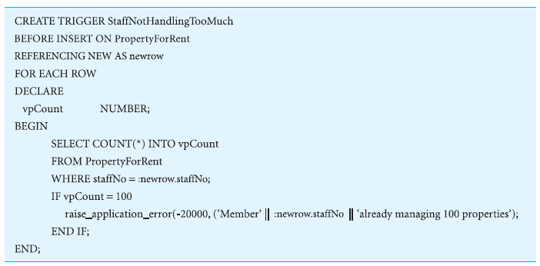
Using a BEFORE Trigger

Slide 17
Types of Triggers
There are two types of triggers:
Row-level triggers (FOR EACH ROW):
Execute once for each row that is affected by the triggering statement.
Fire to the number of records getting affected
Can use New and OLD identifiers
Does not fire if no rows being affected

Slide 18
Types of Triggers
There are two types of triggers:
Statement-level triggers (FOR EACH STATEMENT and it is the default):
Execute once for each triggering statement even if multiple rows are affected by the triggering statement.
Fire once regardless the number of records getting affected
If «for each row» is not mentioned explicitly, then it is a statement level trigger
Cannot use New and OLD identifiers
Fires once even if no rows are affected
Notes:
if you issue an UPDATE statement that affects 20 rows, the row-level trigger will be invoked 20 times, while the statement-level trigger will be invoked 1 time performing its action(s) on the 20 rows in one go

Slide 19
Advantages of Triggers
Advantages:
Reduce redundant code
Increased security
Improved integrity
Good fit with the client-server architecture
Notes:
Reduce redundant code: Instead of having copies of the trigger in every client application, the trigger is stored only once in the database.
Increased security: Storing triggers in the database gives them all the security benefits provided automatically by the DBMS.
3) Improved integrity: Triggers can be extremely useful for implementing integrity constraints. Storing such triggers in the database means that integrity constraints can be enforced consistently by the DBMS.
4) Good fit with the client-server architecture: A single request from a client can result in a whole sequence of checks by the database server. In this way, performance is improved as data and operations are not transferred across the network between the client and the server.

Slide 20
Disadvantages of Triggers
Disadvantages:
Performance overhead
Cascading effects (recursive triggers)
Cannot be scheduled
Less portable
Notes:
Performance overhead: The management and execution of triggers have a performance overhead that must be balanced against the advantages cited previously.
Cascading effects. The action of one trigger can cause another trigger to be fired, and so on, in a cascading manner. It can be hard to foresee this effect when designing the trigger.
Cannot be scheduled. Triggers occur when the event that they are based on happens.
Less portable: Every DBMSs implement their own syntax for triggers, which affects portability.
The main drawback of using trigger is that you must know the trigger exists and understand its logic in order to figure it out the effects when data changes.
They must be used with caution
A judicious use of integrity constrain can replace the use of triggers

Slide 21
Transaction Management

Slide 22
What is a Transaction?
A transaction is a group of operations (one or more SQL queries) that are handled as one logical operation.
In practice, this means that you may have many operations:
if any of these operations fails, the entire group of operations is treated as fail
and the database is restored (rolled back) to its state before the group of operations was started.
The COMMIT and ROLLBACK commands are used to confirm and undo a transaction, respectively.
Proper transaction management is a fundamental task for a DBMS.

Slide 23
Example 1 : Bank Transfer
Accounts
AccName | Balance
Alice | 1500
Bob | 750
Transferring 50$ from account Alice to account Bob in a bank
UPDATE accounts
SET Balance = Balance -50
WHERE acctName = Alice;
Subtract 50$ from Alice
UPDATE accounts
SET Balance = Balance +50
WHERE acctName = Bob;
Add 50$ to Bob
Notes:
We need two operations for this!, if they are ok, then the transaction is successful, and the transfer is fine.
We cannot subtract 50$ from one account and not complete the transaction of adding to the other if a system crash occur
If not done, then we UNDO BOTH operations to keep consistency.

Slide 24
Definition of Transaction
SQL has commands COMMIT and ROLLBACK to work with transactions.
For simplicity, we can say that COMMIT means "confirm" and ROLLBACK means "undo".
Although we have entered and executed a sequence of SQL commands, the effect is not final until COMMIT.
ROLLBACK means that the transaction has no effect on the database.
We say that the transaction is undone, or "rolled back".

Slide 25
The four basic properties of a transaction (ACID):
Atomicity
‘All or nothing’ property.
Consistency
Must transform database from one consistent state to another.
Isolation
Partial effects of incomplete transactions should not be visible to other transactions until it is committed.
Durability
Effects of a committed transaction are permanent and must not be lost because of later failure.
These properties are referred to as the ACID properties, by forming an acronym of the first letter in Atomicity, Consistency, Isolation and Durability.
Notes:
Atomicity A transaction cannot be partially executed; it is either performed in its entirety or not performed at all. You copy-paste 1000 rows, or not.
It might not work due to constrain violations, datatype mismatch, syntax error
Consistency although consistency may be violated during transaction.
Isolation Transaction execute independently of one another. The net effect is identical to executing all transactions one after the other in some serial order
Goals of Transaction Management
Ensure that all objects (tables) in the database remain in a consistent state when accessed by multiple transactions at times of database server crashes.
Enforce ACID properties: schedule operations of transactions and use COMMIT and ROLLBACK to ensure atomicity.
Ensure consistency and isolation of concurrent transactions by using locks.
Ensure durability in the event of system failure by using transaction logs.

Slide 26
Example 1 : Bank Transfer
Accounts
AccName | Balance
Alice | 1500
Bob | 750
Transferring 50$ from account Alice to account Bob in a bank
Problems?
Insufficient funds
AccNum Incorrect
Syntax error
UPDATE accounts
SET Balance = Balance -50
WHERE acctName = Alice;
Subtract 50$ from Alice
UPDATE accounts
SET Balance = Balance +50
WHERE acctName = Bob;
Add 50$ to Bob
A: we either transfer the money or we don’t
C: money is not lost nor gained
I: TB should not see changes to Acc Alice and Bob until TA commits
D: the money does not go back to Alice permanently!
Notes:
We need two operations for this!, if they are ok, then the transaction is successful, and the transfer is fine.
We cannot subtract 50$ from one account and not complete the transaction of adding to the other if a system crash occur
If not done, then we UNDO BOTH operations to keep consistency.
ATOMICY doing both operation or none of the 2 operations
Atomicity: should not take money from Alice without giving it to Bob!
Consistency: money is not lost or gained!
Isolation: TB should not see changes to Alice and Bob until completion of TA (i.e., until TA commits).
Durability: the money does not go back to Alice permanently!

Slide 27
Concurrency Control

Slide 28
Need for Concurrency Control
Three examples of potential problems caused by concurrency:
Lost update problem.
Uncommitted dependency problem.
Inconsistent analysis problem.

Slide 29
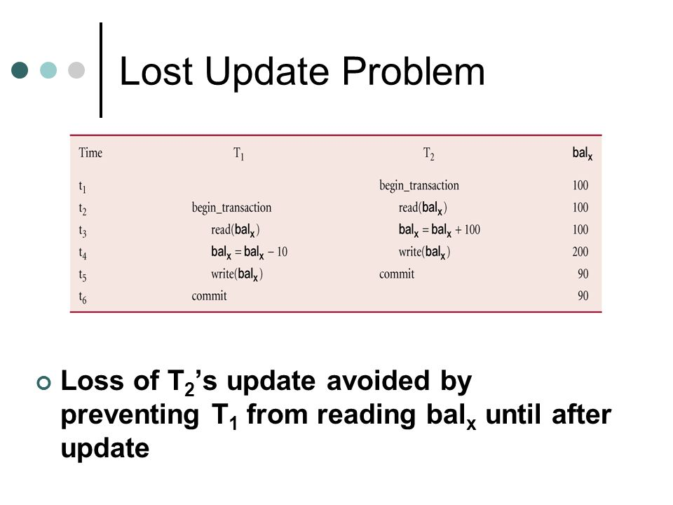
Lost Update
Successfully completed update is overridden by another user.
T1 and T2 are executed concurrently on the same balance of initial value 100 £
T1 withdraws 10$
T2 deposits 100$
T1 is not isolated from T2
T1 overwrites data written by T2
Loss of T2 update avoided by preventing T1 from reading balx until after update

Slide 30
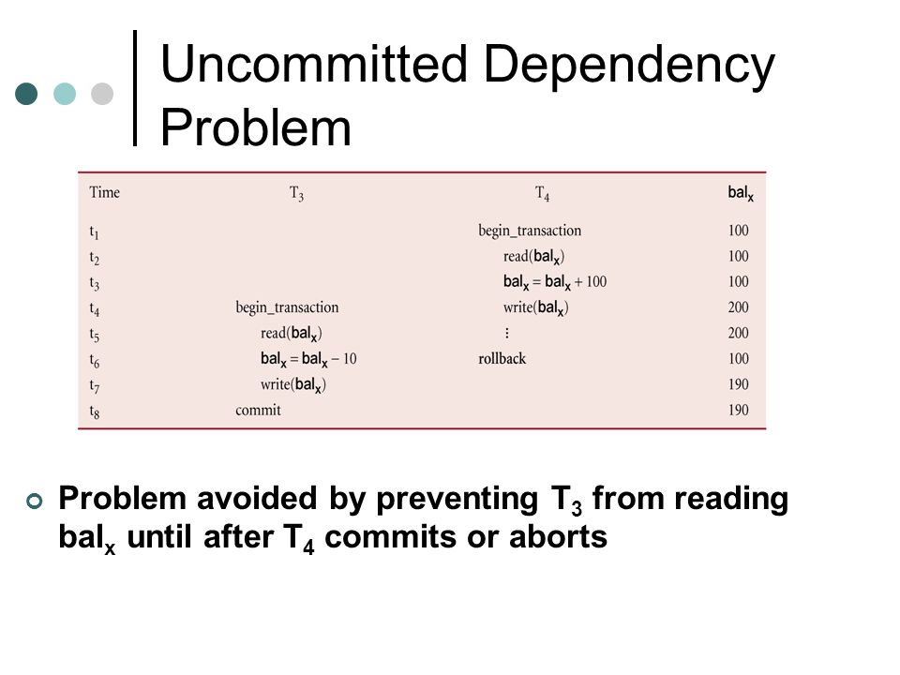
Uncommitted Dependency or Dirty Read
Occurs when one transaction can see intermediate results of another transaction before it has committed.
T3 withdraws 10$
T4 deposits 100$
T4 aborts after updating the balance and its changes (making balance = 200) have been undone (meaning balance value is restored to 100)
T3 is not isolated from T4
Problem avoided by preventing T3 from reading balx until after T4 commits or aborts
Notes:
The reason for the rollback is not important

Slide 31
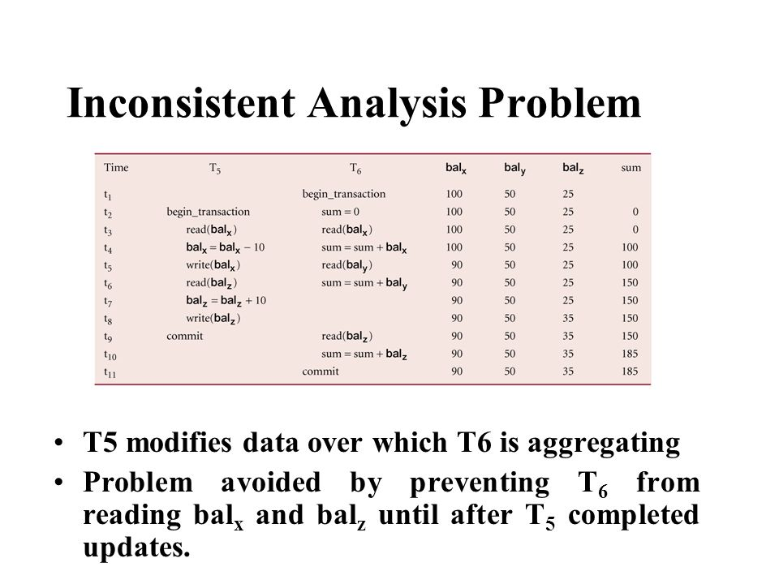
Inconsistent Analysis
Occurs when transaction reads several values but second transaction updates some of them during execution of first.
T5 transfer 10$ from balx to balz
T6 totaling the balance of balx ,baly ,balz
T5 modifies data that T6 is aggregating
Problem avoided by preventing T6 from reading balx and balz until after T5 completed updates
Notes:
RW

Slide 32
Serializability

Slide 33
Serializability
Objective of a concurrency control protocol is to schedule transactions in such a way as to avoid any interference.
Could run transactions serially (one by one), but this limits degree of parallelism in system
Serializability identifies those executions of transactions guaranteed to ensure consistency.
Notes:
The objective of serializability is to find nonserial schedules that allow transactions to execute concurrently without interfering with one another, and thereby produce a database state that could be produced by a serial execution.
If a set of transactions executes concurrently, we say that the nonserial schedule is correct if it produces the same results as some serial executions, such a schedule is called Serializable.
(aim of a multi-user DBMS)

Slide 34
Serializability
R: Read, W: Write O: Object
RT(O): Transaction T reading an object O
WT(O): Transaction T writing an object O
Schedule
Sequence of reads/writes by set of concurrent transactions.
Serial Schedule
Schedule where operations of each transaction are executed consecutively without any interleaved operations from other transactions.
No guarantee that results of all serial executions of a given set of transactions will be identical.
Ex: T1 calculates interest on account D, T2 deposits 100 000$ in account D. Executing (T1 then T2) ≠ Executing (T2 then T1).
T1 | T2
R(A)
W(A)
R(B)
W(B)
Commit
 | R(A)
 | W(A)
 | R(B)
 | W(B)
 | Commit
Notes:
Ex: in banking, it matters whether interest is calculated on an account before a large deposit is made or after.

Slide 35
Nonserial Schedule
R: Read, W: Write O: Object
RT(O): Transaction T reading an object O
WT(O): Transaction T writing an object O
Schedule where operations from set of concurrent transactions are interleaved.
Objective of serializability is to find nonserial schedules that allow transactions to execute concurrently without interfering with one another.
In other words, we want to find nonserial schedules that are equivalent to some serial schedule. Such a schedule is called serializable.
T1 | T2
R(A)
W(A)
 | R(A)
 | W(A)
R(B)
W(B)
 | R(B)
 | W(B)
 | Commit
Commit
Notes:
In example, running T1 first and then T2 gives the same result.
If a set of transactions executes concurrently, we say that the nonserial schedule is correct if it produces the same results as some serial executions, such a schedule is called Serializable.

Slide 36
Serializability
In serializability, ordering of read/writes is important:
(a) If two transactions only read a data item, they do not conflict and order is not important.
(b) If two transactions either read or write separate data items, they do not conflict and order is not important.
(c) If one transaction writes a data item and another reads or writes same data item, order of execution is important.
 | T1 | T2 | Result
Same data item | Read Read Write Write | Read Write Read Write | No conflict Conflict Conflict Conflict
Different data item | Read/Write | Read/Write | No conflict

Slide 37
Conflict Serializable Schedules
Definition: Two schedules are conflict equivalent if and only if:
They involve the same actions of the same transactions, and
every pair of conflicting actions is ordered the same way
Definition: Schedule S is conflict serializable if:
S is conflict equivalent to some serial schedule.

Slide 38
Conflict Serializability – Intuition
A schedule S is conflict serializable if:
You can transform S into a serial schedule by swapping consecutive non-conflicting operations of different transactions.
Example:
R(A)
W(A)
R(B)
W(B)
R(A)
W(A)
R(B)
W(B)
R(A)
W(A)
R(B)
R(B)
W(B)
R(B)
W(B)
W(B)
R(A)
W(A)
R(A)
R(A)
W(A)
W(A)
R(B)
W(B)

Slide 39
Conflict Serializability (Continued)
another example:
Is this schedule Conflict Serializable or not????
R(A)
W(A)
R(A)
W(A)
NOT!

Slide 40
Precedence Graph
Ti
Tj
Precedence (or serialization) graph:
One node per transaction
Edge from Ti to Tj if:
An operation Oi of Ti conflicts with an operation Oj of Tj and
Oi appears earlier in the schedule than Oj.
Theorem: Schedule is conflict serializable if and only if its precedence graph is acyclic.
If the precedence graph is cyclic, the schedule is not conflict serializable.

Slide 41
Example
A schedule that is not conflict serializable:
The cycle in the graph reveals the problem. The output of T1 depends on T2, and vice-versa.
T1: R(A), W(A), R(B), W(B)
T2:
T1: R(A), W(A), R(B), W(B)
T2: R(A), W(A), R(B), W(B)
T1: R(A), W(A), R(B), W(B)
T2: R(A), W(A), R(B), W(B)
T1: R(A), W(A), R(B), W(B)
T2: R(A), W(A), R(B), W(B)
T1: R(A), W(A), R(B), W(B)
T2: R(A), W(A), R(B), W(B)
A
T1
T2
Precedence graph
B

Slide 42
Concurrency Control Techniques

Slide 43
Concurrency Control Techniques
Two basic concurrency control techniques:
Locking,
Timestamping.
Both are conservative approaches: delay transactions in case they conflict with other transactions.
Optimistic methods assume conflict is rare and only check for conflicts at commit.
Notes:
Serializability can be achieved in several ways,
Efficient locking allows us to ensure that only conflict serializable schedules are allowed

Slide 44
Locking
Transaction uses locks to deny access to other transactions and so prevent incorrect updates.
Most widely used approach to ensure serializability.
Generally, a transaction must claim a shared (read) or exclusive (write) lock on a data item before read or write.
Lock prevents another transaction from modifying item or even reading it, in the case of a write lock.
A mechanism used to control access to database objects
Notes:
It’s a set of rules to be followed by each transaction (and enforced by the DBMS) to ensure that , even though actions of several transactions might be interleaved, the net effect is identical to executing all transactions in some order.

Slide 45
Locking - Basic Rules
If transaction has shared(S) lock on item, can read but not update item.
If transaction has exclusive(X) lock on item, can both read and update item.
Reads cannot conflict, so more than one transaction can hold shared locks simultaneously on same item.
Exclusive lock gives transaction exclusive access to that item.
TB requests:
 | X lock | S lock
X lock | N | N
S lock | N | Y
No lock | Y | Y
TA has:
Y: lock can be granted
N: lock is not granted
Notes:
Any transaction that needs to access a data item must first lock the item by requesting a shared lock (S) for read-only access or an exclusive lock (X) for both read and write access.
If the item is not already locked by another transaction, the lock will be granted.
If the item is currently locked, the DBMS determines if the requested lock is compatible with the existing lock. If the requested lock is S on an item that has already S lock on it, the lock will be granted. Otherwise, the transaction must wait until the existing lock is released.
A transaction continues to hold a lock until it explicitly releases it either during execution or when it commits or aborts.
It is only when the exclusive lock has been released that the effects of the write operation will be made visible to other transactions.

Slide 46
Locking - Basic Rules
Some systems allow transaction to upgrade read lock to an exclusive lock, or downgrade exclusive lock to a shared lock.
Data items (or objects) of various sizes (from the entire database, tuple(s) or column(s) in a relation, several relations, to a field or single data value) may be locked.
The larger the data object being locked, the lower the degree of concurrency in the system.

Slide 47
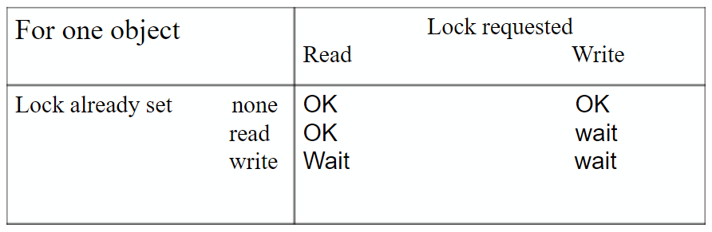
Two-Phase Locking (2P L)
Transaction follows 2 P L protocol if all locking operations precede first unlock operation in the transaction.
Two phases for transaction:
Growing phase - acquires all locks but cannot release any locks.
Shrinking phase - releases locks but cannot acquire any new locks.
If all transactions follow the 2PL protocol, then all possible interleaved (or nonserial) schedules are serializable.
Notes:
Normally, the transaction acquires some locks, does some processing, and goes and acquires additional locks as needed.
A transaction cannot request additional locks once it releases any lock.
Thus, every transaction has a growing phase in which it acquires locks, followed by a shrkining phase in which it releases locks

Slide 48
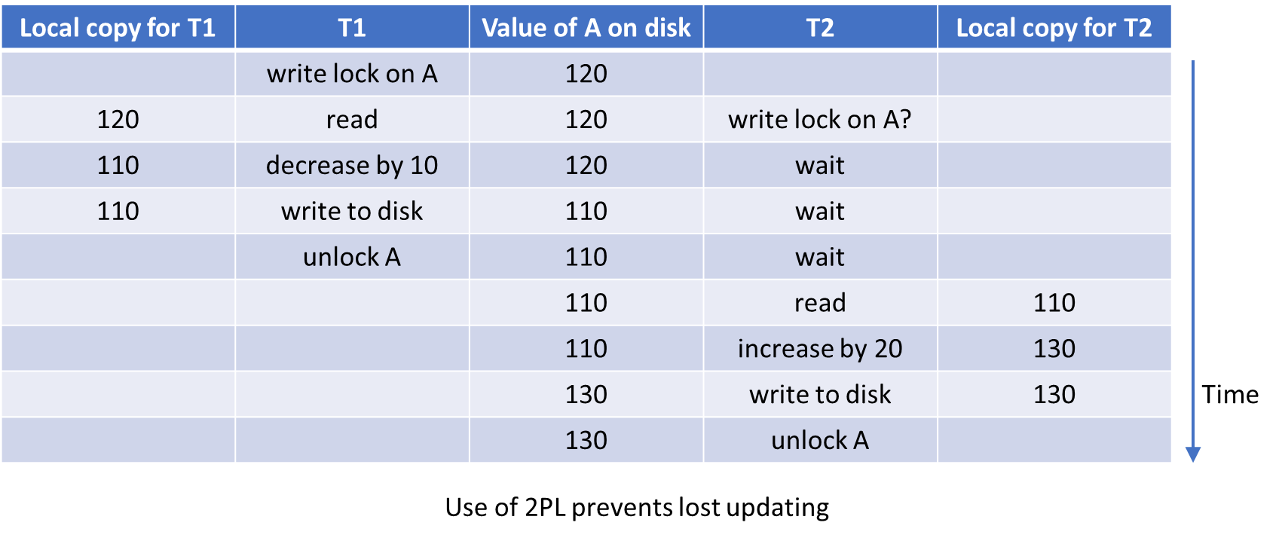
Preventing Lost Update Problem using 2P L
Notes:
Use of locks prevents the concurrency problems of lost updates.
The transactions request write lock before updating values on the disk, and unlock when done.
Transactions that are not granted a write lock because another transaction has already set a lock are put on hold.
Note how T2 is put on hold until T1 is finished.

Slide 49
Deadlock

Slide 50
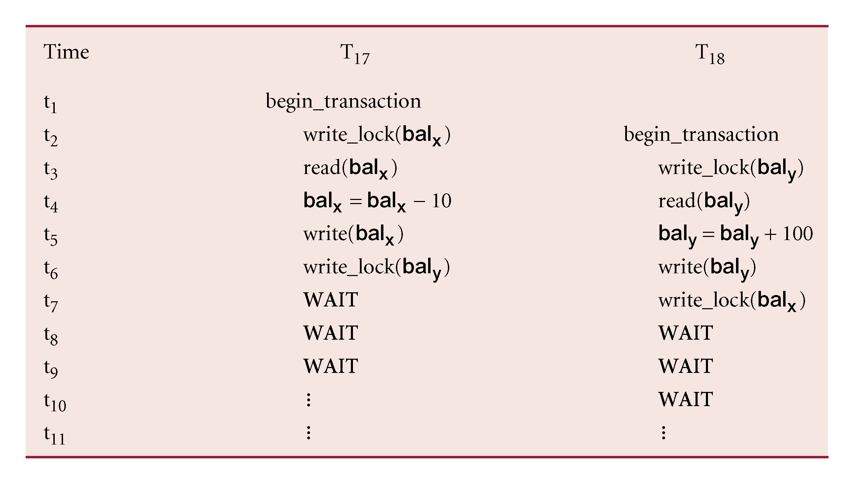
Deadlock
An impasse that may result when two (or more) transactions are each waiting for locks held by the other to be released.
We may decide to abort T18, so that all locks held by T18 are released and T17 is able to continue its operations again.
Notes:
The application involved cannot resolve the problem. Instead, the DBMS has to recognize that deadlock exists and break the deadlock in some way.
IF they keep holding locks, they might stop other transactions too

Slide 51
Deadlock
Only one way to break deadlock: abort one or more of the transactions.
This usually involves undoing all the changes made by the aborted transaction(s).
Deadlock should be transparent to user, so D B M S should automatically restart the aborted transaction(s).
However, in practice D B M S cannot restart aborted transaction since it is unaware of transaction logic even if it was aware of the transaction history (unless there is no user input in the transaction, or the input is not a function of the database state).
Notes:
Time out mechanism

Slide 52
Deadlock
Three general techniques for handling deadlock:
Timeouts.
Deadlock prevention.
Deadlock detection and recovery.

Slide 53
Timeouts
Transaction that requests lock will only wait for a system-defined period of time.
If lock has not been granted within this period, lock request times out.
In this case, D B M S assumes transaction may be deadlocked, even though it may not be, and it aborts and automatically restarts the transaction.
Notes:
Very simple solution used by several commercial database

Slide 54
Backup and Recovery

Slide 55
Database Recovery
Def: Process of restoring database to a correct state in the event of a failure.
Need for Recovery Control
Two types of storage: volatile (main memory) and nonvolatile (DB disk, secondary memory).
Volatile storage does not survive system crashes.
Stable storage represents information that has been replicated in several nonvolatile storage media with independent failure modes.

Slide 56
Types of Failures
System crashes, resulting in loss of main memory.
Media failures, resulting in loss of parts of secondary storage.
Application software errors.
Natural physical disasters.
Carelessness or unintentional destruction of data or facilities.

Slide 57
Transactions and Recovery
Recovery manager is responsible for Atomicity and Durability of transactions.
It ensures atomicity by undoing (aborting) the transactions that do not commit before a failure (T3, T4).
It ensures durability by redoing transactions that committed before a failure and whose impact may not have reached the database disk (T1, T2).
Which transactions will be undone and which ones will be redone?
T1
T2
T3 and T4 must be undone.
T1 and T2 must be redone.
T3
T4
Failure
Time

Slide 58
Recovery Facilities
DBMS should provide following facilities to assist with recovery:
Backup mechanism, which makes periodic backup copies of database.
Logging facilities, which keep track of current state of transactions and database changes.
Checkpoint facility, which enables updates to database in progress to be made permanent.
Recovery manager, which allows DBMS to restore database to consistent state following a failure.

Slide 59
Log File
Contains information about all updates to database:
Transaction records.
Checkpoint records.
Often used for other purposes (for example, auditing).

Slide 60
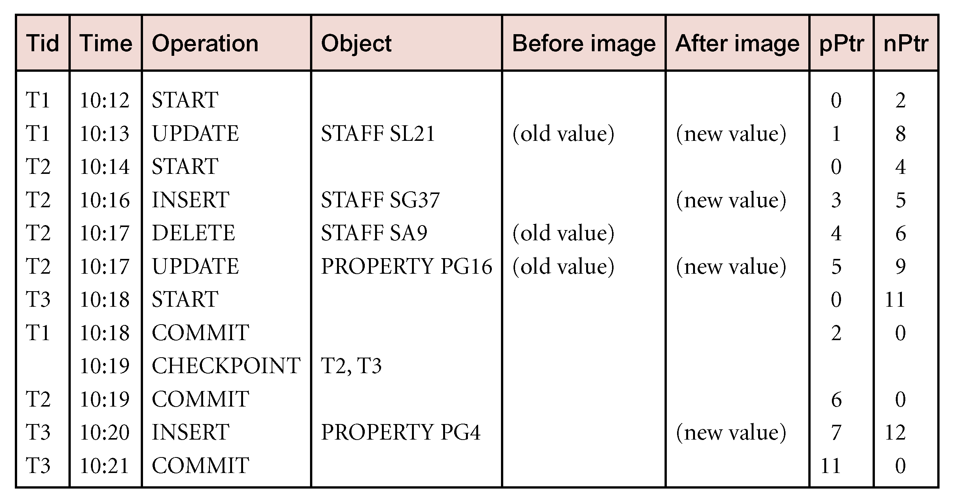
Log File
Transaction records contain:
Transaction identifier (Tid).
Type of log record (Operation): it includes transaction start, insert, update, delete, abort, commit.
Identifier of data item (Object) affected by database action (insert, delete, and update operations).
Before-image of data item (old value).
After-image of data item (new value).
Log management information.
Notes:
The Figure illustrates a segment of a log file that shows three concurrently executing transactions T1, T2, and T3.
The columns pPtr and nPtr represent pointers to the previous and next log records for each transaction.
Two or three separate copies of log files are created so that if a copy is damaged, another can be used.

Slide 61
Reconstruction with Transaction Log
After an error situation (e.g., power outage), we can use the transaction log to get the database content back in a consistent state.
The transaction log can be used for recovery after errors in two ways:
UNDO: Because the log contains both old and new values for all write operations, we can reverse the effect of a transaction by reading the log backwards and replacing new values with old ones. We say that the transaction is "rolled back".
REDO: By reading the log, interrupted transactions (committed transactions whose effect did not reach the DB disk) can be carried out again, from the beginning. Here, old values will be overwritten by new ones.

Slide 62
Checkpointing
Checkpoint
Point of synchronization between database and log file. All buffers are force-written to secondary storage (DB disk).
Checkpoint record is created containing identifiers of all active transactions.
When failure occurs, redo all transactions that committed since the checkpoint and undo all transactions active at time of crash.

Slide 63
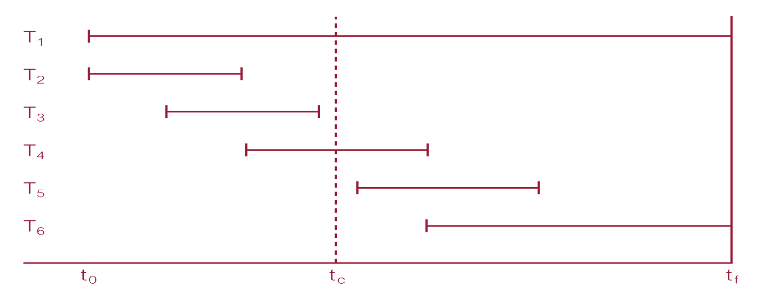
Checkpointing
In this example, DBMS starts at time t₀, but fails at time t_{f} with checkpoint at time t_{c}.
Changes made by T₂ and T₃ have been written to secondary storage (T1 and T2 commit before t_{c}).
Thus:
only redo T₄ and T₅,
undo transactions T₁ and T6.

Slide 64
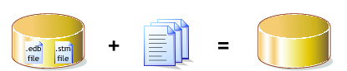
Recovery Techniques
If database has been damaged:
Need to restore last backup copy of database and reapply updates of committed transactions using log file.
If database is only inconsistent:
Need to undo changes that caused inconsistency. May also need to redo some transactions to ensure updates reach secondary storage.
Do not need backup, but can restore database using before- and after-images in the log file.
DB Backup Log Files Consistent DB

Slide 65
Main Recovery Techniques
Two main recovery techniques:
Deferred Update
Immediate Update

Slide 66
Deferred Update
Updates are not written to the database until after a transaction has reached its commit point.
If transaction fails before commit, it will not have modified database and so no undoing of changes required.
May be necessary to redo updates of committed transactions as their effect may not have reached the DB disk.

Slide 67
Immediate Update
Updates are applied to database as they occur.
Must redo updates of committed transactions following a failure.
May need to undo effects of transactions that had not committed at time of failure.
Essential that log records are written before write to database. Write-ahead log protocol.

Slide 68
Immediate Update
If no “transaction commit” record in log, then that transaction was active at failure and must be undone.
Undo operations are performed in reverse order in which they were written to log.

Slide 69
Summary
The log is stored on disk, not in memory, If the system crashes it is preserved
Recovery Manager guarantees Atomicity & Durability.
Checkpointing: A quick way to limit the amount of log to scan on recovery.
Deferred → we do not have to undo the changes of an aborted transaction because these changes have not been written to DB disk.
Immediate → we must redo the changes of a committed transaction if there is a subsequent crash because all these changes are not guaranteed to have been written to DB disk at commit time.

Slide 70
We stopped here

Slide 71
Query Optimization

Slide 72
Relational Algebra (2 of 2)
The basic operations in relational algebra are:
Selection ( σ ) Selects a subset of rows from relation (horizontal).
Projection ( π ) Retains only wanted columns from relation (vertical).
Cross-product ( × ) Allows us to combine two relations.
Set-difference ( — ) Tuples in r1, but not in r2.
Union ( ∪ ) Tuples in r1 and/or in r2.
Intersection (∩)
Join ( )
Division ( / )
These perform most of the data retrieval operations needed.

Slide 73
Example - Selection (or Restriction)
List all staff with a salary greater than £10,000.
staff N o | f Name | l Name | position | sex | D O B | salary | branch N o
S L21 | John | White | Manager | M | 1-Oct-45 | 30000 | B005
S G37 | Ann | Beech | Assistant | F | 10-Nov-60 | 12000 | B003
S G14 | David | Ford | Supervisor | M | 24-Mar-58 | 18000 | B003
S G5 | Susan | Brand | Manager | F | 3-Jun-40 | 24000 | B003
Works on a single relation R and defines a relation that contains only those tuples (rows) of R that satisfy the specified condition (predicate).

Slide 74
Example - Projection
Produce a list of salaries for all staff, showing only staff N o, f Name, l Name, and salary details.
staff N o | f Name | l Name | salary
S L21 | John | White | 30000
S G37 | Ann | Beech | 12000
S G14 | David | Ford | 18000
S A9 | Mary | Howe | 9000
S G5 | Susan | Brand | 24000
S L41 | Julie | Lee | 9000
Works on a single relation R and defines a relation that contains a vertical subset of R, extracting the values of specified attributes and eliminating duplicates.

Slide 75
Example - Cartesian Product
List the names and comments of all clients who have viewed a property for rent.
client.client N o | f Name | l Name | Viewing.client No | property N o | comment
CR76 | John | Kay | CR56 | PA14 | too small
CR76 | John | Kay | CR76 | PG4 | too remote
CR76 | John | Kay | CR56 | PG4 | Blank
CR76 | John | Kay | CR62 | PA14 | no dining room
CR76 | John | Kay | CR56 | PG36 | Blank
CR56 | Aline | Stewart | CR56 | PA14 | too small
CR56 | Aline | Stewart | CR76 | PG4 | too remote
CR56 | Aline | Stewart | CR56 | PG4 | Blank
CR56 | Aline | Stewart | CR62 | PA14 | no dining room
CR56 | Aline | Stewart | CR56 | PG36 | Blank
Defines a relation that is the concatenation of every tuple of relation R with every tuple of relation S.

Slide 76
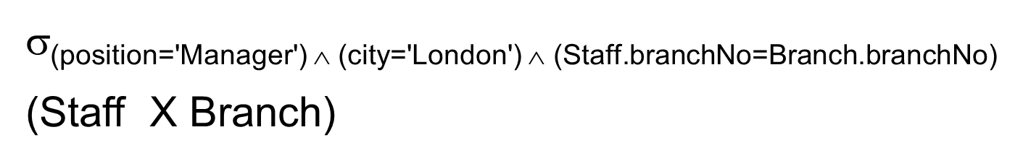
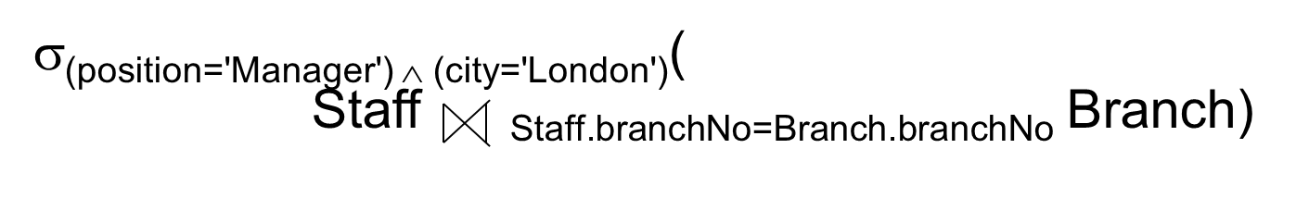
Different Strategies (1 of 2)
Find all Managers who work at a London branch.
SELECT *
FROM Staff s, Branch b
WHERE s.branch N o = b.branch N o AND
(s.position = ‘Manager’ AND b.city = ‘London’);
(1)
(2)
Three equivalent R A queries are:
(3)

Slide 77
Different Strategies (3 of 3)
Assume:
1000 tuples in Staff; 50 tuples in Branch;
50 Managers; 5 London branches;
no indexes or sort keys;
results of any intermediate operations stored on disk;
cost of the final write is ignored;
tuples are accessed one at a time (although in practice disk accesses is based on blocks, which would typically contain several tuples).

Slide 78


Cost Comparison
Cost (in disk accesses) are:
(1)
(2)
(3)
Option (3) is 87 times faster than option (1).
Cartesian product and join operations much more expensive than selection, and third option significantly reduces size of relations being joined together.
Tutorial 5: explaining and analyzing query execution plans in PostgreSQL
Notes:
The first query calculates the Cartesian product of Staff and Branch, which requires (1000 + 50) disk accesses to read the relations, and creates a relation with (1000 * 50)
tuples. We then must read each of these (1000 * 50) tuples again to test them against the selection predicate at a cost of another (1000 * 50) disk accesses, giving a total cost of:
(1000+50) + 2*(1000 * 50) = 101 050 disk accesses.
The second query joins Staff and Branch on the branch number branchNo, which again requires (1000 + 50) disk accesses to read each of the relations. We know that the join
of the two relations has 1000 tuples, one for each member of staff (a member of staff can only work at one branch). Consequently, the Selection operation requires 1000 disk
accesses to read the result of the join, giving a total cost of:
2*1000 + (1000 + 50) = 3050 disk accesses
The final query first reads each Staff tuple to determine the Manager tuples, which requires 1000 disk accesses and creates a relation with 50 tuples. The second
Selection operation reads each Branch tuple to determine the London branches, which requires 50 disk accesses and creates a relation with 5 tuples. The final operation is
the join of the reduced Staff and Branch relations, which requires (50+5) disk accesses, giving a total cost of:
1000 + 2*50+5+(50 + 5) = 1160 disk accesses

Slide 79
How to find a Good Plan Tree?
The planner can create multiple trees first, and then pick the one having the lowest cost
Determining the best plan tree for an SQL command is called planning

Slide 80
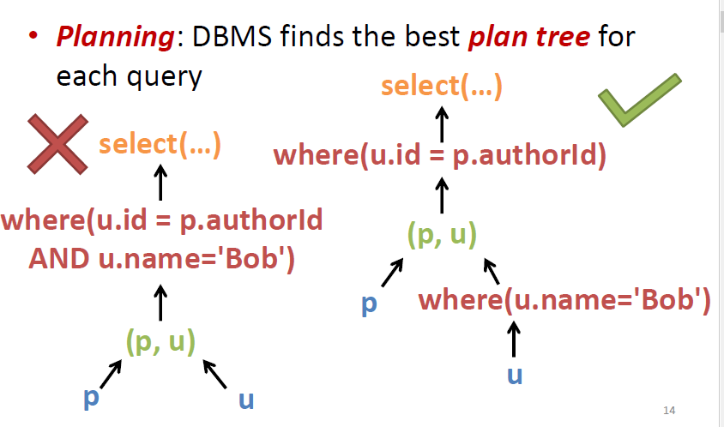
Query Optimization

Slide 81
What is Query Optimization?
Query optimization is the activity of choosing an efficient query execution plan.
Systematic estimation of the cost of different query execution plans and choosing the one with the lowest cost
Estimation of plan cost is based on statistical information about relations (e.g., number of tuples, number of distinct values, etc.)
It is about making decisions about data access methods
It depends on the file organization
How it works?
SQL queries are decomposed into query blocks
Each query block is translated to an equivalent relational algebra expression and represented as a query tree of logical operators
Blocks are separately optimized (cost-based query optimization)
Cost estimates should consider disk accesses and cardinality of the relation (tuples)

Slide 82
Query Optimization Example
SQL query transformed into corresponding relational algebra query trees
SELECT ENAME
FROM EMPLOYEE, WORKSON, PROJECT
WHERE PNAME = ‘database’ AND
PNUM = PNO AND
ENO = ENUM AND
BDATE > ‘1965’
Canonical tree
This query tree (procedure) will compute the correct result.
However, the performance will be very poor.
→ needs optimization !

Slide 83
Algorithm

Slide 84
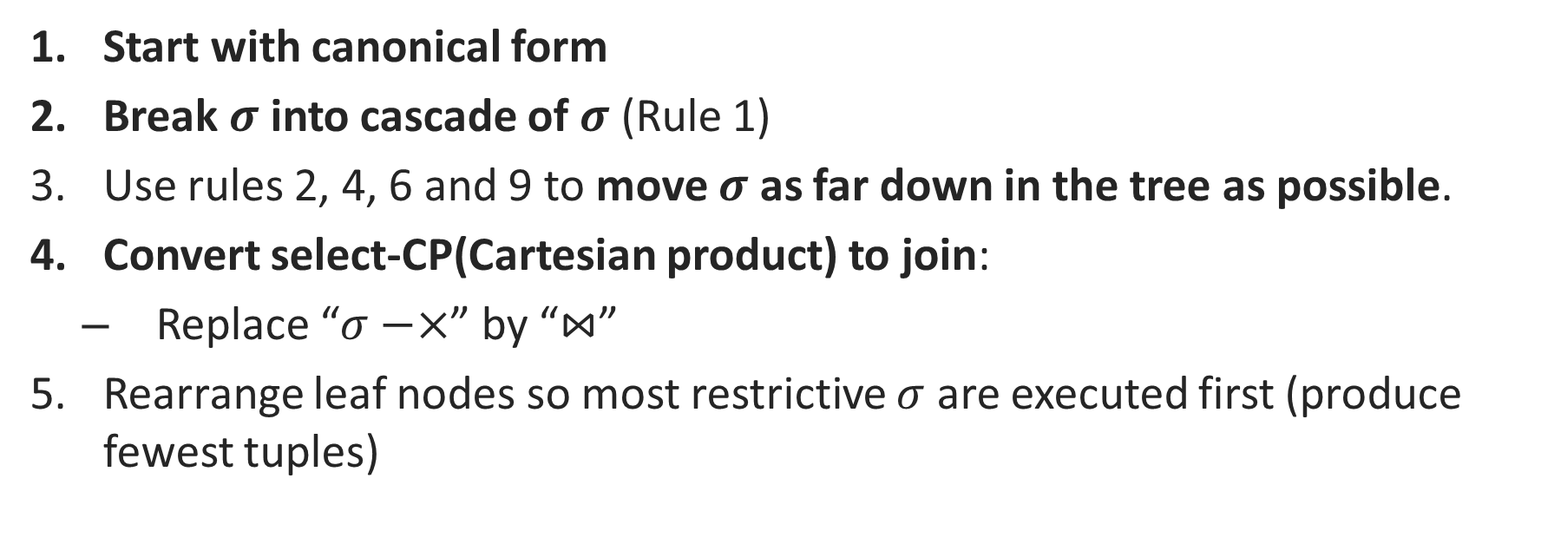
Algorithm
Start with canonical form
Break $σ$ into cascade of $σ$ (Rule 1)
Use rules 2, 4, 6 and 9 to move $σ$ as far down in the tree as possible.
Convert select-CP(Cartesian product) to join:
Replace “$σ−×$” by “$⋈$”
Rearrange leaf nodes so most restrictive $σ$ are executed first (produce fewest tuples)

Slide 85
Example

Slide 86
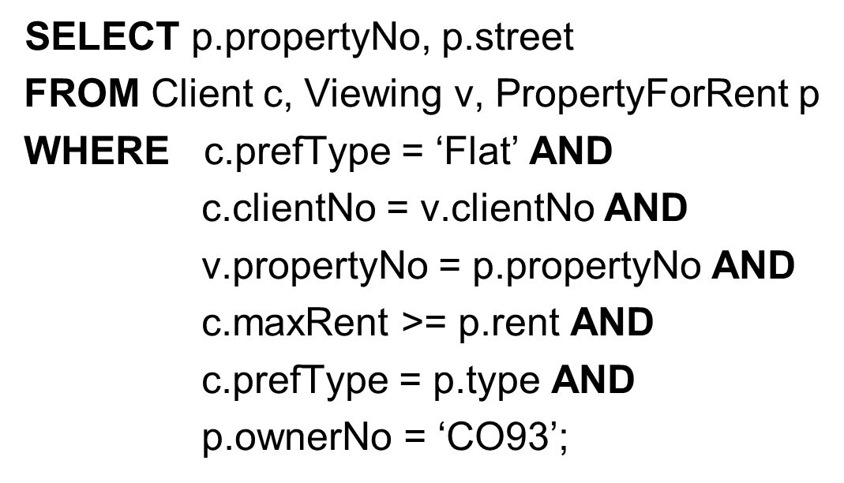
Query Optimization Example (1 of 7)
For prospective renters of flats, find properties that match requirements and owned by C O93

Slide 87
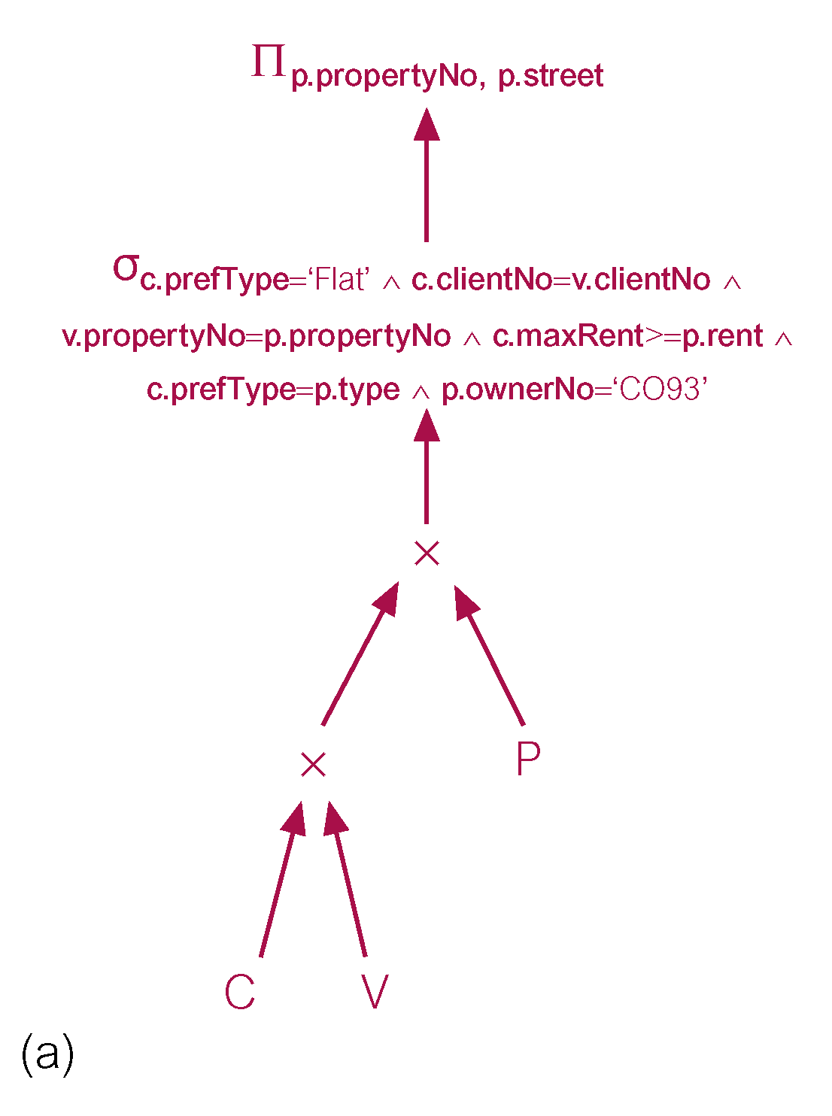
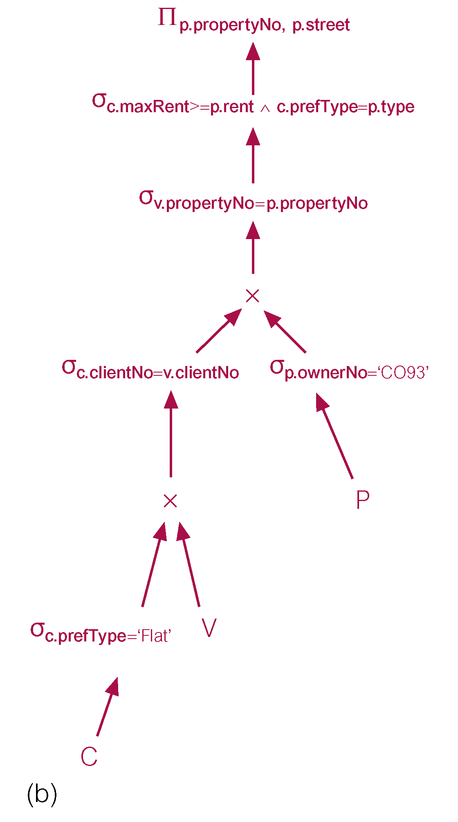
Query Optimization Example (2 of 7)
(a) canonical relational algebra tree
(b) relational algebra tree formed by pushing Selections down

Slide 88
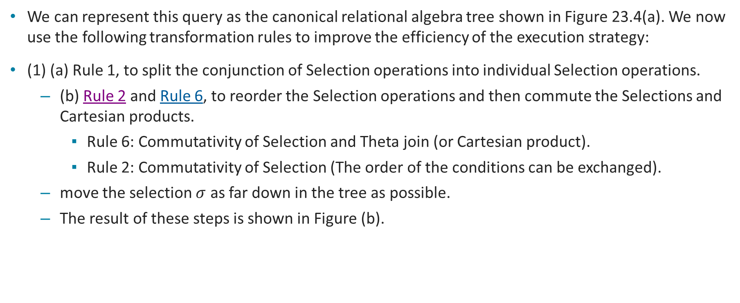
Query Optimization Example (3 of 7)
We can represent this query as the canonical relational algebra tree shown in Figure 23.4(a). We now use the following transformation rules to improve the efficiency of the execution strategy:
(1) (a) Rule 1, to split the conjunction of Selection operations into individual Selection operations.
(b) Rule 2 and Rule 6, to reorder the Selection operations and then commute the Selections and Cartesian products.
Rule 6: Commutativity of Selection and Theta join (or Cartesian product).
Rule 2: Commutativity of Selection (The order of the conditions can be exchanged).
move the selection $σ$ as far down in the tree as possible.
The result of these steps is shown in Figure (b).

Slide 89
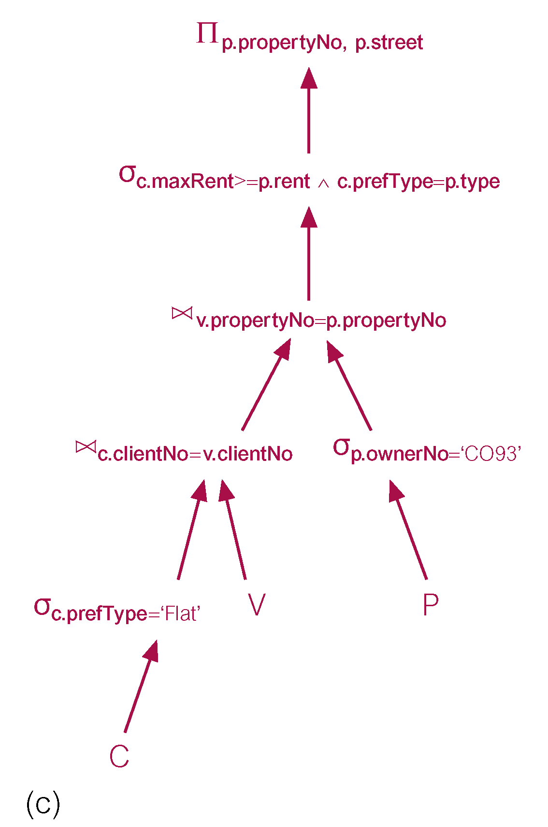
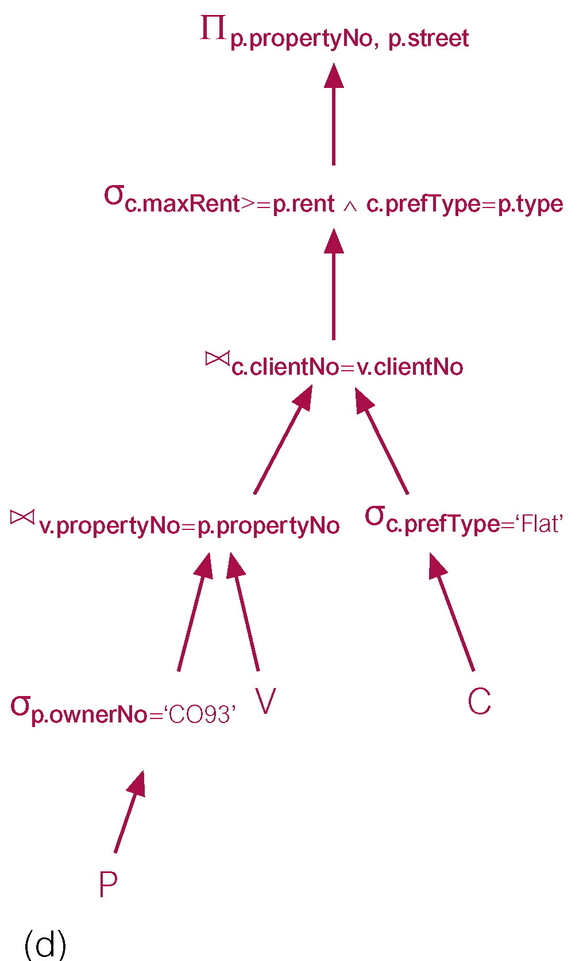
Query Optimization Example (4 of 7)
(c) relational algebra tree formed by replacing “𝜎−×” by “⋈” (changing Selection/Cartesian products to Equijoins)
(d) Rearrange leaf nodes so most restrictive 𝜎 are executed first

Slide 90
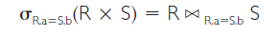
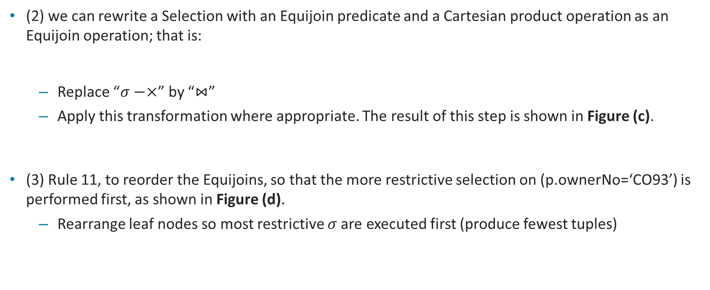
Query Optimization Example (5 of 7)
(2) we can rewrite a Selection with an Equijoin predicate and a Cartesian product operation as an Equijoin operation; that is:
Replace “$σ−×$” by “$⋈$”
Apply this transformation where appropriate. The result of this step is shown in Figure (c).
(3) Rule 11, to reorder the Equijoins, so that the more restrictive selection on (p.ownerNo=‘CO93’) is performed first, as shown in Figure (d).
Rearrange leaf nodes so most restrictive 𝜎 are executed first (produce fewest tuples)

Slide 91
Heuristical Processing Strategies
Perform Selection operations as early as possible.
Keep predicates on same relation together.
Combine Cartesian product with subsequent Selection whose predicate represents join condition into a Join operation.
Use associativity of binary operations to rearrange leaf nodes so leaf nodes with most restrictive Selection operations executed first.
Perform Projection as early as possible.
Keep projection attributes on same relation together.

Slide 92
Denormalization

Slide 93
Denormalization
What is it?
It is the refinement to the relational schema such that the degree of normalization for a modified relation is less than the degree of at least one of the original relations (so-called: usage refinement)
Example:
Denormalized: Branch (branchNo, street, city, postcode, mgrStaffNo)
Normalized:
Branch (branchNo, street, postcode, mgrStaffNo)
Postcode (postcode, city)
Notes:
CONTROLLED REDUNDANCY

Slide 94
Advantages and Disadvantages of Denormalization
Advantages | Disadvantages
Can improve performance by: | May speed up retrievals but can slow down updates.
precomputing derived data; | Always application-specific and needs to be re-evaluated if the application changes.
minimizing the need for joins; | Can increase the size of relations.
reducing the number of foreign keys in relations; | May simplify implementation in some cases but may make it more complex in others.
reducing the number indexes (thereby saving storage space); | Sacrifices flexibility.
reducing the number of relations. | Blank

Slide 95
XML and JSON

Slide 96
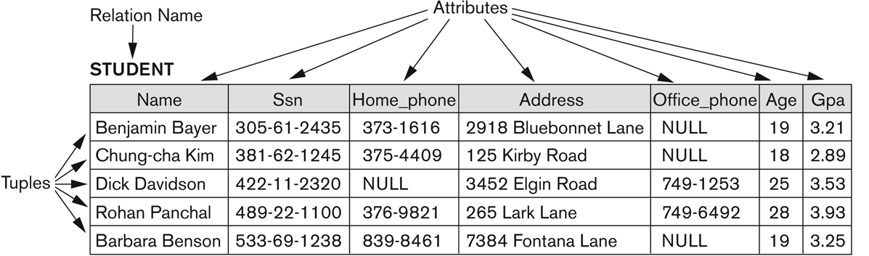
Structured, Semi-structured, and Unstructured Data
Structured data
Stored in relational database and represented in a strict format
Notes:
Relational DBs are represented in a strict format that follows the structures and constraints specified in the schema
Vertical homogeneity
Horizontal homogeneity

Slide 97
Structured, Semi-structured, and Unstructured Data
Unstructured data
Data has no structure
Example: images, audio, video.

Slide 98
Semi-structured Data
Data that has some structure, but the structure may not be rigid, regular, or complete, and generally the data does not conform to a fixed schema (e.g., e-mail, XML documents, social media feeds).
There are many kinds of semi-structured data.
In some cases, information associated with a schema is contained within the data itself, like in XML (self-describing data).
In some data, there is no schema (Schema-less).
In some other data, the schema exists but places loose constraints on the data.
Example: Tuples with varying number of fields

Slide 99
Semi-structured Data
Example:
There is no predefined schema as opposed to relational databases.
Instead, there is a loose self-describing schema.
The columns aren't defined in this case.
Alison in the second row doesn't have a PersonType value, but that’s not considered as non-valid in semi-structured data.
If Ken in row one doesn't have a title, that’s OK. The columns don't need to be the same across rows.
This is as opposed to Relational DB, where we have vertical and horizontal homogeneity.
Person ID: 1 | PersonType: Employee | FirstName: Ken
Person ID: 2 | Title: Ms. | FirstName: Alison
Person ID: 3 | PersonType: Customer | Title: Mr. | FirstName: Roberto
No vertical homogeneity
No horizontal homogeneity

Slide 100
XML

Slide 101
What is XML?
XML stands for eXtensible Markup Language.
XML is a markup language much like HTML
XML was designed to store and transport data over the Internet.
XML was designed to be self-descriptive
XML was designed to be both human- and machine-readable.

Slide 102
XML Example
XML prolog informs of the version XML conforms to; the character encoding scheme used in the document.
UTF-8 is the default character encoding for XML documents, it allows to interpret correctly international characters, like Norwegian ø æ å
XML is self-descriptive:
This note has sender, receiver information, a heading and a message body.
The note element starts with an opening tag <note> and ends with a closing tag </note>.
<?xml version="1.0" encoding="UTF-8"?> <note> <to>Tove</to> <from>Jani</from> <heading>Reminder</heading> <body>Don't forget me this weekend!</body> </note>

Slide 103
XML and HTML Differences
XML and HTML were designed with different goals:
XML was designed to carry data - with focus on what data is
HTML was designed to display data - with focus on how data looks
XML tags are not predefined like HTML tags are
XML Does Not Use Predefined Tags
The XML language has no predefined tags.
The tags in the example in previous slide (like <to> and <from>) are not defined in any XML standard. These tags are "invented" by the author of the XML document.
HTML works with predefined tags like <p>, <h1>, <table>, etc.
With XML, the author must define both the tags and the document structure.

Slide 104
XML Motivation
XML is Extensible, unlike HTML, i.e., users can add new tags.
XML Simplifies data sharing, data transport, platform changes, and data availability.
Many computer systems contain data in incompatible formats. Exchanging data between incompatible systems is a time-consuming task and requires data to be converted, and incompatible data is often lost.
XML stores data in plain text format. This provides a software- and hardware-independent way of storing, transporting, and sharing data.
XML also makes it easier to expand or upgrade to new operating systems, new applications, or new browsers, without losing data.

Slide 105
XML Tree Structure
XML documents are formed as trees.
An XML tree starts at a root element (<bookstore>)and branches from the root to child element (<book>).
The <book> element have 4 child elements <author>, <year>, and <price>
The element title has text content (Harry Potter) and attributes (lang="en") <title lang="en">Harry Potter</title>
The book element starts with an opening tag <book> and ends with a closing tag </book>.
<?xml version="1.0" encoding="UTF-8"?> <bookstore> <book category="children"> <title lang="en">Harry Potter</title> <author>J K. Rowling</author> <year>2005</year> <price>29.99</price> </book> <book category="web"> <title lang="en">Learning XML</title> <author>Erik T. Ray</author> <year>2003</year> <price>39.95</price> </book> </bookstore>

Slide 106
XML Syntax Rules
An XML document must have a single root element that is the parent of all other elements.
All XML elements must have a closing tag. It is illegal to omit the closing tag.
XML tags are case sensitive. The tag <Letter> is different from the tag <letter>. Opening and closing tags must be written with the same case.
Valid:<message>This is correct</message>
Not Valid:<Message>This is wrong</message>
XML elements must be properly nested
Proper nesting: <book> … <title> …. </title> </book>
Improper nesting: <book> … <title> …. </book> </title>

Slide 107
XML Syntax Rules
XML Attribute Values Must Always be Quoted: XML elements can have attributes in name/value pairs just like in HTML. In XML, the attribute values must always be quoted: <note date="12/11/2007">
Entity References: Some characters have a special meaning in XML.
If you place a character like "<" inside an XML element, it will generate an error because the parser interprets it as the start of a new element.
To avoid this error, replace the "<" character with an entity reference: &lt;
Wrong Syntax: <message>salary < 1000</message>
Correct Syntax: <message>salary &lt; 1000</message>

Slide 108
XML Syntax Rules
There are 5 pre-defined entity references in XML:
&lt; < less than
&gt; > greater than
&amp; & ampersand
&apos; ‘ apostrophe
&quot; " quotation mark
Comments in XML: The syntax for writing comments in XML is like that of HTML:
Valid comment: <!-- This is a comment -->
Two dashes in the middle of a comment are not allowed:
<!-- This is an invalid -- comment -->

Slide 109
JSON

Slide 110
JSON - Introduction
JSON stands for JavaScript Object Notation.
JSON is a text format for storing and transporting data.
JSON is a lightweight data-interchange format used to send data between computers (including API requests and responses).
Since JSON format is text only, JSON data can easily be sent between computers.
JSON is a self-describing, easy to understand, and can be used in any programming language.
JSON can be easily transformed into a JavaScript object (more details in the upcoming slides) for further manipulations.

Slide 111
JSON - Introduction
This example is a JSON object:
{"name":"John", "age":30, "car":null, "approved": true}
It defines an object with 4 attributes: name, age, car, approved.
Each attribute is a key value pair, where the key is the label of the attribute.
You can access the data in the JSON object as:
personName = obj.name;
personAge = obj.age;
The corresponding JSON string is:
'{"name":"John", "age":30, "car":null, "approved": true}'
key
value

Slide 112
JSON Syntax for Objects
JSON syntax is derived from JavaScript object notation syntax:
Data is written in key/value pairs
Data is separated by commas
No trailing comma
Curly braces { } hold objects
Key must be surrounded with double quotes
A key/value pair consists of a field name, followed by a colon, followed by a value: "name":"John"
A value can be string, number, Boolean, null, even an array, or other objects.
A string value must be in double quotes, while numerical and Boolean values don’t need quotes in JSON.
{
"name":"John",
"age":30,
"car":null,
"approved": true
}

Slide 113
JSON Syntax for Arrays
An array is a list of values in order
Arrays have no keys, but has only values
Square brackets are used to hold arrays
No trailing comma in arrays
[
" Henry Chu",
"Amanda Singh",
"Carmen Gutierrez"
]
[
{ "firstName":"John", "lastName":"Doe" }, { "firstName":"Anna", "lastName":"Smith" }, { "firstName":"Peter", "lastName":"Jones" }
]
Array of strings
Array of objects

Slide 114
Why Use JSON?
A JavaScript program can easily convert JSON string into JSON object.
JavaScript has a built-in function for converting JSON strings into JavaScript objects: JSON.parse()
JavaScript also has a built-in function for converting an object into a JSON string: JSON.stringify()
You can receive pure text from a server and use it as a JavaScript object.
var person= '{"name":"John", "age":30, "car":null}’;
//code to parse the person variable
var personParsed=JSON.parse(person);
personParsed.name="Gilbert";
personParsed.age=25;
//convert the object personParsed to a JSON string
var Person2= JSON.stringify(personParsed);

Slide 115
JSON vs XML
Both JSON and XML can be used to receive data from a web server.
<employees> <employee> <firstName>John</firstName> <lastName>Doe</lastName> </employee> <employee> <firstName>Anna</firstName> <lastName>Smith</lastName> </employee> <employee> <firstName>Peter</firstName> <lastName>Jones</lastName> </employee> </employees>
{"employees":[ { "firstName":"John", "lastName":"Doe" }, { "firstName":"Anna", "lastName":"Smith" }, { "firstName":"Peter", "lastName":"Jones" } ]}
JSON Example
XML Example

Slide 116
JSON vs XML (Similarities)
Both JSON and XML are "self describing" (human readable)
Both JSON and XML are hierarchical (values within values)
Both JSON and XML can be parsed and used by lots of programming languages
Both JSON and XML can be fetched with an XMLHttpRequest

Slide 117
JSON vs XML (Differences)
JSON doesn't use end tag as opposed to XML.
JSON is shorter than XML.
JSON is quicker to read and write than XML.
JSON can use arrays, while XML cannot use arrays.
XML must be parsed with an XML parser. JSON can be parsed by a standard JavaScript function.
JSON is Better Than XML because:
XML is much more difficult to parse than JSON.
JSON is parsed into a ready-to-use JavaScript object.
XML takes more storage space.

Slide 118
Big Data and NoSQL

Slide 119
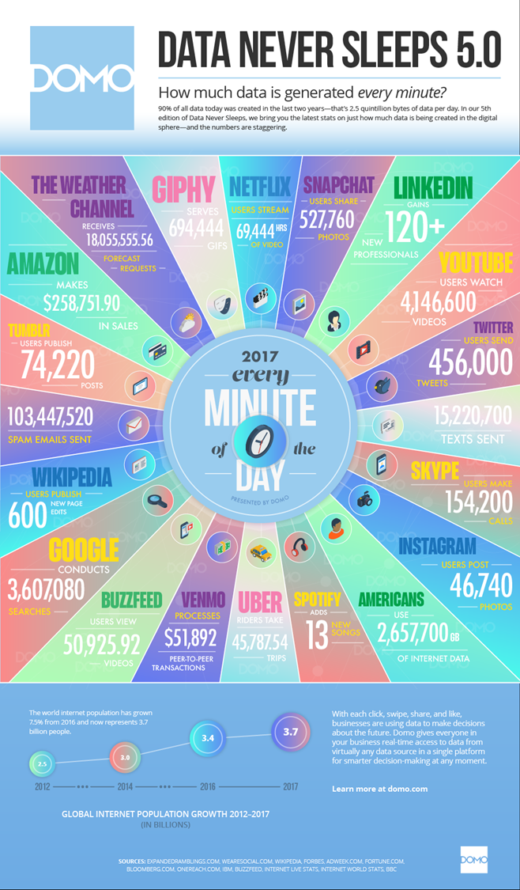
Why Big Data?
Very large volumes of data being collected.
Driven by growth of web, social media (FB, YouTube, etc.), and the internet-of-things (sensor data from industrial and residential areas)
Analytics on big data has great value for advertisements, consumer behavior analysis, sentiment analysis, opinion mining, marketing, web site structuring, what posts to show to a user (FB), etc.

Slide 120
Big Data
Big data ranges from terabytes (1000 Gigabytes), petabytes (1000 terabytes) to Exabytes (1000 petabytes=Billion Gigabytes).
Performing analysis on large scale datasets is termed as big data analytics.
Big data analytics requires transaction processing systems with high scalability
Many applications willing to sacrifice ACID properties and other database features, if they can get very high scalability
These applications must support non-relational data (semi-structured and unstructured data).

Slide 121
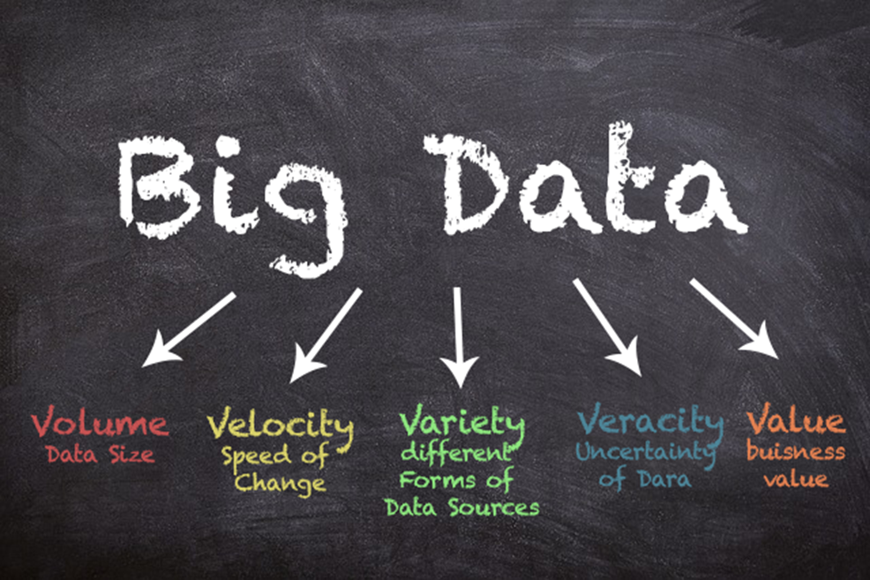
The 5 Vs of Big Data

Slide 122
The 5 Vs of Big Data
Volume: refers to the large amount of data managed by the system. We are talking about thousands of Exabytes.
On Facebook alone, 10 billion posts per day and 350 million picture uploads each day.
We can store and use this big data with the help of distributed file systems, where parts of the data is stored in different locations, connected by networks and brought together by software.
Velocity refers to the speed at which new data is generated. Real time video streaming from thousands of surveillance cameras, data from thousands of sensors deployed in smart cities.
Big data technology now allows us to analyze the data while it is being generated.

Slide 123
The 5 Vs of Big Data
Variety refers to the different types of data we can now use. This includes structured (relational data), semi-structured (XML, JSON), and unstructured data (photo, audio, video).
Big data analytics involve data fusion which consists of using heterogenous data types (structured, semi-structured, and unstructured data) and analyze them together.
Fire forecasting requires the use of satellite images (unstructured data), weather data (structured data), sensor data on the ground, pictures posted from users of the area of interest to forecast the movement of the flames in the coming hours.

Slide 124
The 5 Vs of Big Data
Veracity refers to the uncertainty in the data. The data could be of bad quality or noisy and need to be preprocessed to improve its quality.
Building a model on inaccurate data leads to inaccurate and unreliable model that has no value. Models and collected data must be evaluated through quality testing or credibility analysis.
Value refers to our ability to turn our data into a business value. It is important that an organization define their objectives before collecting and leveraging big data.
It is easy to fall into the buzz trap and embark on big data initiatives without a clear understanding of the business value it will bring.

Slide 125
Big Data Storage Systems
Big data ranges from terabytes (1000 Gigabytes), petabytes (1000 terabytes) to Exabytes (1000 petabytes).
Performing analysis on large scale datasets is termed as big data analytics.
Big data analytics requires transaction processing systems with high scalability
Many applications willing to sacrifice ACID properties and other database features, if they can get very high scalability
These applications must support non-relational data (semi-structured and unstructured data).
Big data is stored in a distributed file system.

Slide 126

Distributed File Systems
A distributed file system stores data across a large collection of machines, but provides single file-system view
Highly scalable distributed file system for large data-intensive applications.
E.g., 10K nodes, 100 million files, 10 petabytes of data.
Provides redundant storage of massive amounts of data on cheap and unreliable computers
Files are replicated to handle hardware failure
Detect failures and recovers from them
Examples:
Google File System (GFS)
Hadoop Distributed File System (HDFS)

Slide 127
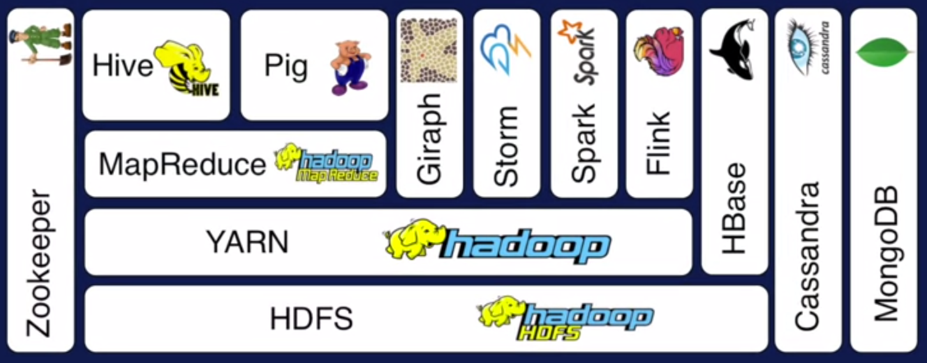
Hadoop Ecosystem
Notes:
The Hadoop distributed file system, or HDFS, is the foundation for many big data frameworks, since it provides scalable and reliable storage. As the size of your data increases, you can add commodity hardware to HDFS to increase storage capacity so it enables scaling out of your resources.
Hadoop YARN provides flexible scheduling and resource management over the HDFS storage. YARN is used at Yahoo to schedule jobs across 40,000 servers. MapReduce is a programming model that simplifies parallel computing.
Instead of dealing with the complexities of synchronization and scheduling, you only need to give MapReduce two functions, map and reduce. This programming model is so powerful that Google previously used it for indexing websites. MapReduce only assume a limited model to express data.
Hive and Pig are two additional programming models on top of MapReduce to augment data modeling of MapReduce with relational algebra and data flow modeling respectively. Hive was created at Facebook to issue SQL-like queries using MapReduce on their data in HDFS. Pig was created at Yahoo to model data flow based programs using MapReduce.

Slide 128
Hadoop
The Hadoop distributed file system, or HDFS, is the foundation for many big data frameworks
Hadoop provides scalable and reliable storage.
As the size of your data increases, you can add commodity hardware to HDFS to increase storage capacity
This enables scaling out of your resources.

Slide 129
YARN
Hadoop YARN provides flexible scheduling and resource management over the HDFS storage.
YARN is used at Yahoo to schedule jobs across 40,000 servers.
YARN can dynamically allocate pools of resources to applications according to their needs.

Slide 130
MapReduce
MapReduce is a programming model that simplifies parallel computing.
you only need to give MapReduce two functions, map and reduce.
This programming model is so powerful that Google previously used it for indexing the whole internet content.

Slide 131
Example of MapReduce
The canonical MapReduce example counts the appearance of each word in a set of documents.
Each document is split into words, and each word is counted by the map function, using the word as the result key.
MapReduce puts together all the pairs with the same key and feeds them to the same call to reduce.
Reduce just needs to sum all its input values to find the total appearances of that word.
Based on a sentence typed by a user in google MapReduce returns the list of relevant websites. The website where the occurrence of the keywords typed by the user is ranked and showed first in the result list.

Slide 132
Example of MapReduce
function map(String name, String document):
// name: document name
// document: document contents
for each word w in document:
emit (w, 1)
function reduce(String word, Iterator partialCounts):
// word: a word
// partialCounts: a list of aggregated partial counts
sum = 0
for each pc in partialCounts:
sum += pc
emit (word, sum)

Slide 133
NoSQL

Slide 134

NoSQL
NoSQL stands for Not only SQL.
The rise of big data lead to the need for new tools to create business value out of this big data.

Slide 135
NoSQL
Most N o S Q L systems are distributed databases with distributed storage systems
Focus on scalability
semi-structured data
distributed storage
high performance
high availability
data replication
parallel processing.

Slide 136
NoSQL
Does not use relational model, no strict consistency and schemas are not required
Allows to freely add fields to database records without having to define any changes in structure first.
This is particularly useful when dealing with non-uniform data and custom fields.
Tends to be Open Source
Mostly do not use SQL as a query language.
NoSQL databases are not meant to replace RDBMS but to complement them (they are used together in some scenarios).
Notes:
(e.g., document (XML and JSON) and graph databases).
Ex. Facebook, images videos, adds
they tend to be designed to run on a cluster
you can store any data in any record
Emphasize performance and flexibility over modelling power and complex queries—semi-structured data

Slide 137
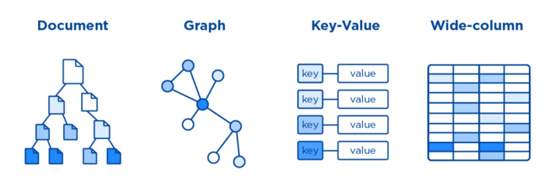
Four major types of NoSQL database
Key-Value Databases
Wide-column Databases
Graph Databases
Document Databases
The NoSQL database family and their representations.
List of NoSQL databases: http://nosql-database.org/
Notes:
https://pub.towardsai.net/exploring-the-nosql-family-49e9f23313ad

Slide 138
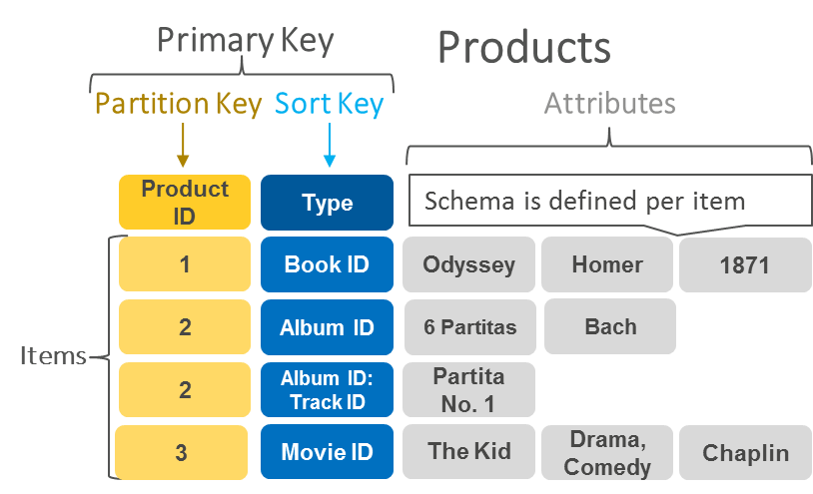
Key-Value DBs
Notes:
The simplest flavor of NoSQL databases
revolves around the concept of associative arrays, in other words, it simply ties a given key to a record of any type, from a simple string or JSON to video files.
Key-value databases are organized into partitions, which can contain one or several entities, and each record is represented by a unique row key.
Records in turn contain one or multiple fields.
The concept of partition and row keys is one of the most critical aspects of NoSQL as it allows for logical partitions (defined by the partition key) to be moved around physical partitions (nodes) according to their workload.

Slide 139
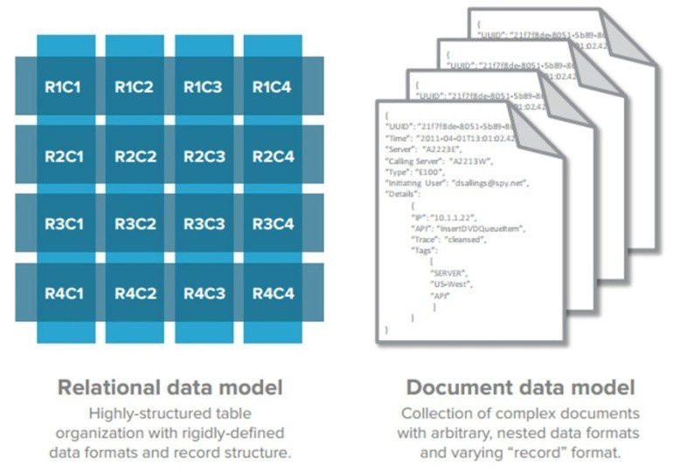
Document Databases
Relational data model vs Document data model
Notes:
Document Store databases build on the concept behind key-value, extending it to support complex multi-layered objects named documents.
This seemingly simple difference has several consequences: because the engine is familiar with the multi-level or nested concept,
all fields, including nested fields, are indexed allowing for specific field query and selection

Slide 140
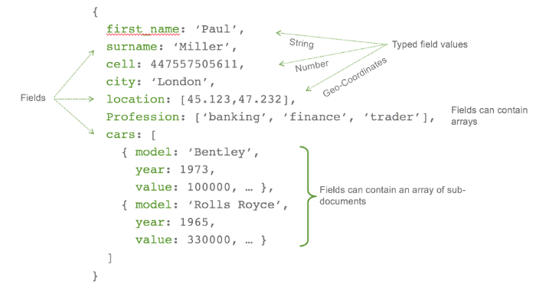
Document Databases
Document store structure
Notes:
This is a JSON file

Slide 141
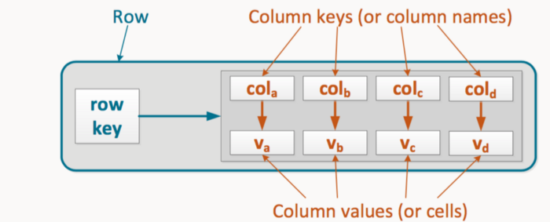
Column Family Databases
Column store schema
Notes:
Column family databases share concepts with both RDBMS and key-value stores.
You can think of the rows as keys in a key-value store, and the columns as the value.
Their optimal use case is for large data ingestion or data analytics, being suitable for storing billions of rows and tens of thousands of columns.

Slide 142
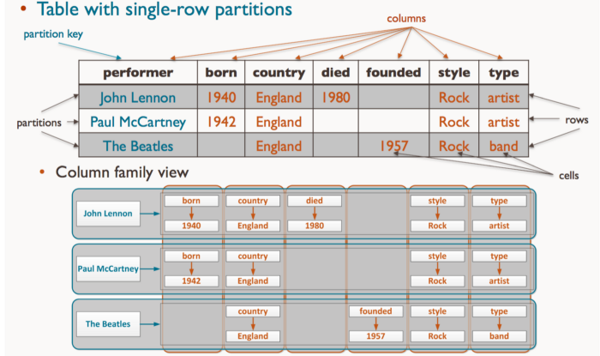
Column Family Databases
Column store schema
Notes:
The data model behind the column means it can efficiently handle sparse matrices, a major difficulty for traditional RDBMS.
Whereas in RDBMS all columns must be filled — recall NULL is a value and the occupied space corresponds to the column’s type — occupying storage,
Column Family Databases only nonempty columns occupy storage space, in fact, it only stores existing values per column, for each row (or key). But empty columns do not occupy storage space for Column Family Databases.

Slide 143
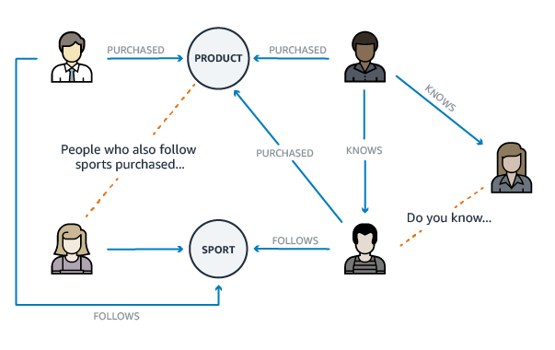
Graph Databases
Graph engine recommendation engine example
Notes:
The last NoSQL database types shift the focus onto the relationship between entities. Entities, such as users, are represented by nodes, whereas the connections between entities dictate how they are related.
Graph databases store the relationship information within each node, by doing so, the need for lookup operations needed in relational databases is removed, saving much-needed resources.
Graph databases are designed for data whose relations are well represented as a graph consisting of elements connected by a finite number of relations.
Examples of data include social relations, public transport links, road maps, network topologies

Slide 144
Graph Databases
Vendors
Neo4j
OrientDB
ArangoDB
Use cases:
Knowledge Graphs
Identity Graphs
Fraud Detection
Recommendation Engines
Social Networks

